Slide 1
Introduction to Social Buzz project
As a role of Data Analyst for Accenture, my role is to analyse the Social Buzz business and find the reasons of category of viewers used on the website and help in
Digital promotion of business.

Slide 2
Problems with the Social Buzz Business
They are looking to complete an IPO by the end of next year and need guidance to ensure that this goes smoothly.
They are still a small company and do not have the resources to manage the scale that they are currently at. They could hire more people, but they want an experienced practice to help instead.
They want to learn data best practices from a large corporation. Due to the nature of their business, they have a massive amount of data so they are keen on understanding how the world's biggest companies manage the challenges of big data.

Slide 3
Expectations from the company through our service
An audit of their big data practice
Recommendations for a successful IPO.
An analysis of their content categories that highlights the top 5 categories with the largest aggregate popularity.

Slide 4
Parameters used in the project for analysis:
Category
Sentiment
Type
Score

Slide 5
Process of Extracting the Sample file to analyse
As a data analyst, my first work was to analyse the dataset given by them which was several csv files.
On analysing them, I came up with a single csv file which contains combination of 3 csv files.
I came up with this file using different joins in SQL and on the basis of main work as a role of data analyst which is:
An analysis of their content categories that highlights the top 5 categories with the largest aggregate popularity.

Slide 6
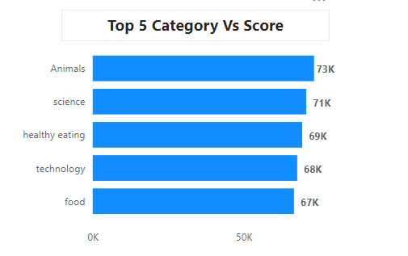
Visualization or charts used in the analysis
Top 5 Category Vs Score:
Based on the score, we can clearly see that
Animals category has got the most score
overall i.e. mostly Animals category is viewed.

Slide 7
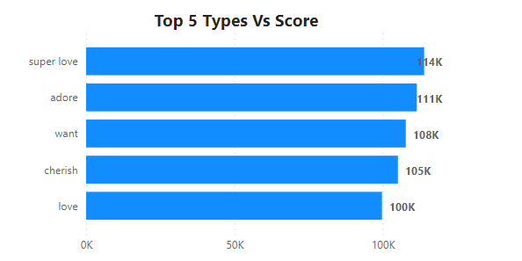
Visualization or charts used in the analysis
Top 5 Reaction Types Vs Score:
Super love reaction is mostly given by
users of the social media.

Slide 8
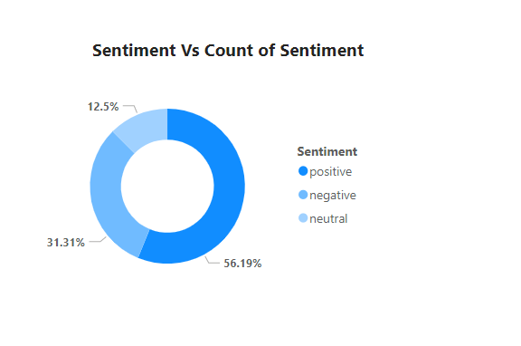
Visualization or charts used in the analysis
Sentiment analysis by count:
Positive sentiment is mostly given by social
media users which is around more than 50%.

Slide 9
Insights and Recommendations
Viewers of Social Buzz website mostly views content of categories: Animals, Healthy Eating, Food, Science and Technology.
Recommendation would be to upload more content on these categories to uplift the business as they are the most popular.

